Slide 1

Lloyds Banking Group AVD Bicep Workshop (day 3)
Michael Ross (CSA)

Slide 2
Agenda – Day 3
09:00 – Review of Day 2
09:30 – AVD Components – Lab 3
10:15 – Break
10:30 – AVD Hosts and Testing – Lab 4
12:00 – Lunch
13:00 – Finish Lab 4 and Open Afternoon Q&A
15:00 – Break
16:30 – Workshop review

Slide 3
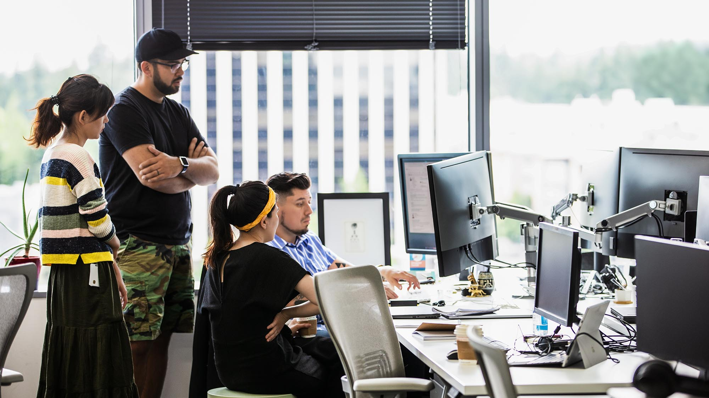
Workshop Day 3

Slide 4
Welcome Back
So where did we get to?
Overview of the Architecture
Setting up the environment
Review of Bicep
Base infrastructure deployment
So what’s left?
Finish deploying the AVD components
Deploy the AVD hosts
Test it

Slide 5
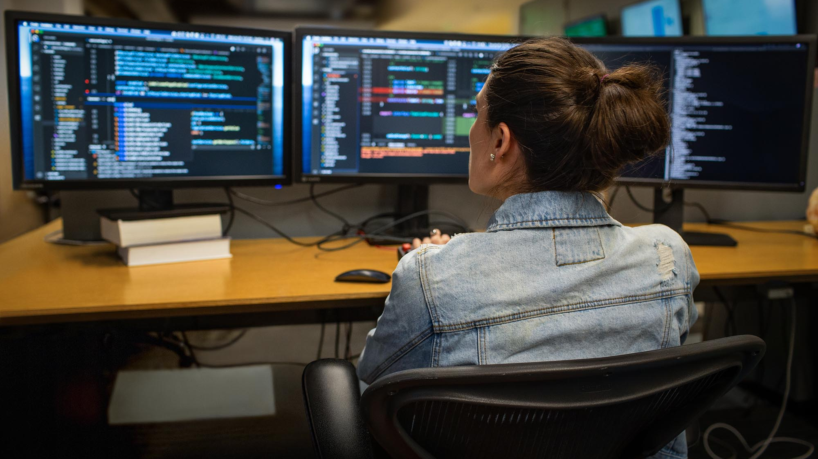
Lab 3 – AVD Components (to finish)

Slide 6
Break Time Back in 15 mins
"Using Azure Bicep is like a carpenter using power tools for the first time. It can be scary at first, but once you get the hang of it, you'll wonder how you ever managed without it. And just like with power tools, you'll want to make sure you wear your safety glasses and have a first-aid kit handy!“
Mark Russinovich, CTO of Microsoft Azure

Slide 7
AVD Components
And now onto the main event
In this lab we will build out and deploy the main components required for an AVD service including:
AVD Host Pool
AVD Workspace
AVD Application Group

Slide 8
Lab 4 – AVD Hosts

Slide 9
AVD Hosts
The Final Lab
In this final lab we will be building out the AVD hosts and adding them to the Host Pool
Add Hosts
Add extensions
Test it all works – log into your own AVD desktop
Party!

Slide 10
Testing
Testing your AVD
Make sure of the following:
You have hosts up and running
The hosts are visible in the host pool
The RBAC permissions have been set in the Application Group
Then connect to:
https://client.wvd.microsoft.com/arm/webclient/index.html
You will be asked to log in – use the same credentials as you used for building.
If all was successful you will see a Workspace with a icon for “SessionDesktop”. Click on it and log in.

Slide 11
Lunch Back in 1 hour
"Using Azure Bicep is like having a trusty sidekick that always has your back in the cloud development game. It's the Robin to your Batman, the Sam to your Frodo, the Watson to your Sherlock. With Bicep by your side, you can tackle complex cloud infrastructure challenges with ease, knowing that your sidekick has your back. And who knows, with Bicep in your toolbelt, you might just become the superhero of cloud development yourself!“
Chat-GPT
Notes:
Start recording
John Saville - John Savill's Technical Training – YouTube
https://github.com/mikerossms/AVDDeployment

Slide 12
Demos and Discussions
Over to you
For the rest of the afternoon, we can look at any other elements of AVD that you want to cover.
Examples include:
Using a DevOps pipeline to deploy your code
FSLogix
Walk through of the full code base

Slide 13

Q&A and Review

Slide 14
Break Back in 15 mins
"Developing with Azure Bicep is like having a cheat code for cloud infrastructure - it makes building, deploying, and managing your resources so much easier, you'll wonder how you ever did it without it.”

Slide 15
Wrapping Up
So what did we learn?
The structure of a typical AVD deployment
The required resources to make it work
The IaC Bicep content for each resource
How all that Bicep code work together
How to deploy it all using a powershell script

Slide 16
Questions?
“I fundamentally believe that if you are not learning new things, you stop doing great and useful things. So family, curiosity, and hunger for knowledge all define me.“
Satya Nadella, CEO Microsoft

Slide 17

Thank you and well done

